Slide 1
Breeding Across Isolated Populations of Skyros Lizards
Hannah Hartung

Slide 2
Motivation

Slide 3
Original Author
My Study

Slide 4
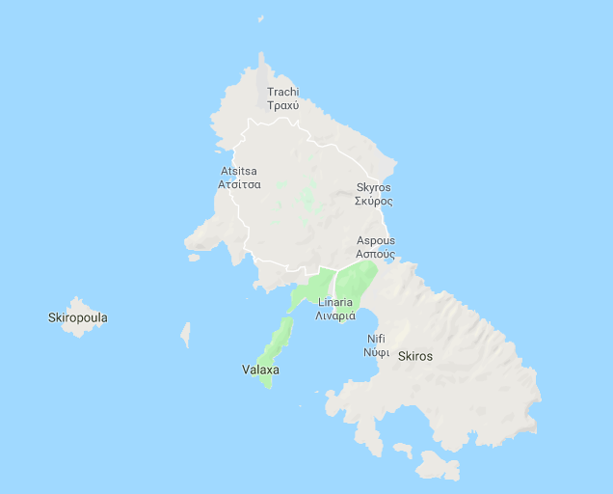
Individuals collected from 4 “Mainland” and 4 “Islet” locations.

Slide 5
To what extent do the effects of genetic drift affect the breeding potential for cross-site pairs?

Slide 6
To what extent do the effects of genetic drift affect the breeding potential for cross-site pairs?
?

Slide 7
Sub-questions
Do males and females from the same locations mate better together?
How does geographic distance between islets and mainland impact breeding compatibility?
Does sea distance versus over land distance have different impact on breeding compatibility?

Slide 8
Between the mainland and islets
Who mates with who how fast?
How do their diets and behaviors affect breeding habits?
Who is attracted to who else’s pheromones?
100 kB
Several Files
< 100 kB
88 kB
Combination of several data sets

Slide 9
Anticipated Results
Female
Island Mainland
Compatibility
Island Mainland
Home Distance
Male

